Slide 1
NON-PHARMACOLOGIC BEHAVIOR MANAGEMENT TECHNIQUES
Pennsylvania Association of Community Health Centers
2016 Annual Conference & Clinical Summit
Alicia Risner-Bauman, DDS, FADPD
Fellow, Academy of Dentistry for Persons with Disabilities, ABSCDA
NYS Special Care Dentistry Task Force
ADA Council on Access Prevention and Inter-professional Relations
PA Head Start Association Special Care Dentistry Consultant
Pennsylvania Coalition for Oral Health Board of Directors
PDA Committee on Access to Care
PA Department of Health: Advisory Health Board
ACHIEVA Task Force on Education

Slide 2
Learning Objectives
PURPOSE: To introduce health care professionals to behavior management techniques to overcome informational, physical, and behavioral challenges faced in providing care to patients with complex needs.
PARTICIPANT WILL LEARN:
1. Strategies to prepare patients and care givers for health care visits
2. How to develop and discuss behavior management plans
3. Monitoring and documentation requirements for behavior interventions.

Slide 3
Disclosures
Dr. Risner-Bauman does not have any financial or other interests in any of the products, services, drugs, or other items discussed or shown or recommended in this presentation.
Any interests are purely educational, recommendations are the results of years of practice and research.
All photos presented are either available publicly or are used with the permission of the subjects or legal guardians in the photos for use in educational settings.
If you are not here to be educated, you must leave immediately or tightly close your eyes whenever there is a photograph on the screen.
“ The stories you are about to hear are true. The names have been changed to protect the innocent. “ Friday (a cop), Dragnet.

Slide 4
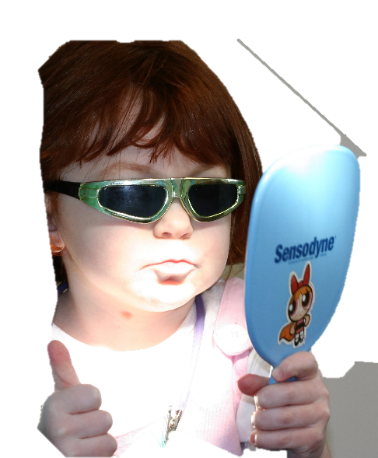
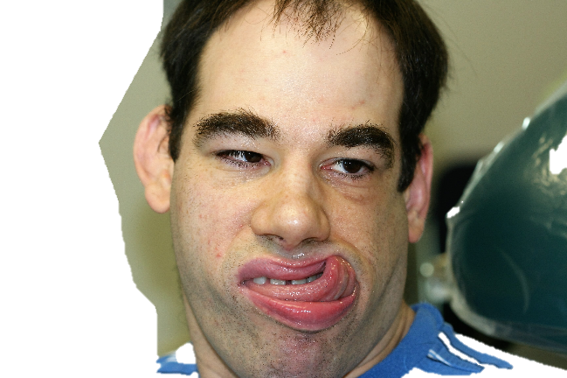
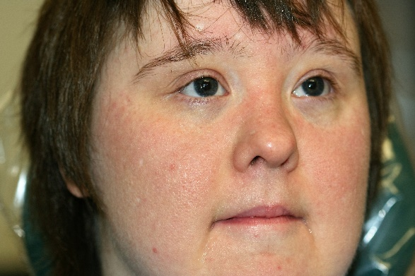
Special Needs Patients
  The term “Special Needs Patient” is used in the oral health field to describe an individual with special needs, including physical, medical, developmental and/or cognitive conditions, resulting in limitations in their ability to receive dental services and prevent oral diseases by maintaining daily oral hygiene. Special Care Dentistry Association, 2009
Notes:
These are techniques that can be utilized with any patient in any setting.

Slide 5
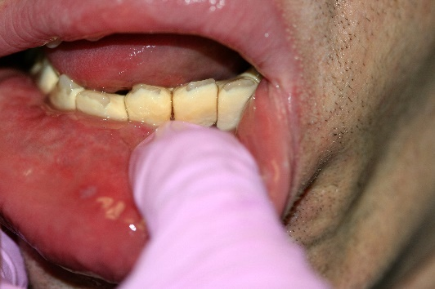
Individuals with limitations are at risk for dental disease
They may not know how to care for teeth.
They may be unable to care for teeth.
Their care givers may not know how to provide care or understand importance of oral care.
Care givers may not be able to provide adequate care.
Obtaining dental services is often difficult.
Transportation can often be difficult.
Oral Health in America: A Report of the Surgeon General 2000
Notes:
Many of these limitations easily extend to the community at large, especially the patients seen at FQHCs.

Slide 6
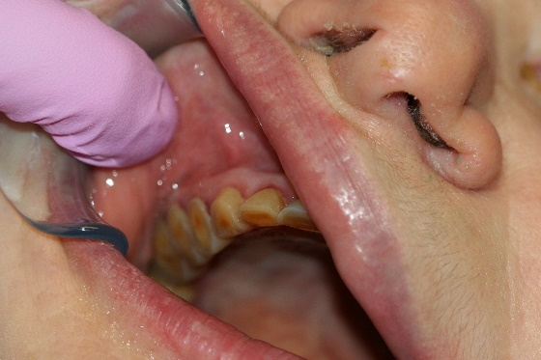
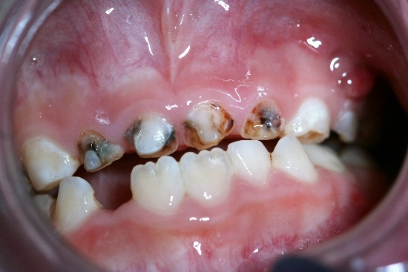
Individuals with limitations are at risk for dental disease
Paying for care is often difficult, especially for those requiring sedation.
            Medicare does not cover dental services.
              Medicaid benefits vary by state and can be limited, especially for individuals who do not live in institutional settings.
Center for Health Care Strategies, Inc. Feb, 2016

Slide 7
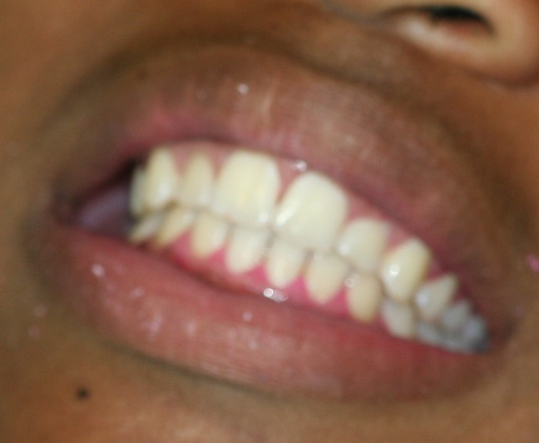
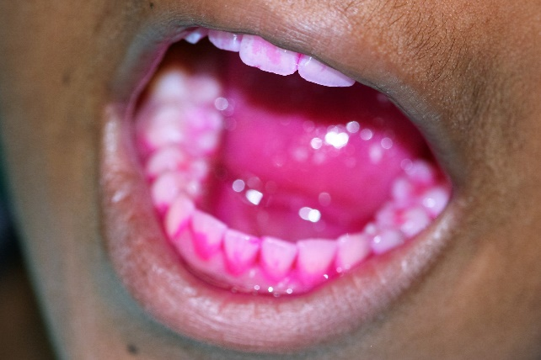
Goals of the Oral Health Plan
To prevent and treat diseases of the oral cavity and surrounding structures.
To help the individual being assisted become as independent as possible in self-care.
To make oral health a routine part of daily activities.
To make each personal and professional oral care session successful.

Slide 8
Training Needed
Care givers receive limited training directed specifically to oral hygiene
Fear of injury to self and/or person caring for
Unable to overcome resistance to care
Limited knowledge of oral health
  What disease looks like
  How disease develops
  Relationship of oral disease to systemic health
Poorly developed oral health plans
Risner-Bauman, A. “Overcoming Obstacles to Oral Health Care: A Follow Up Study”. 19th Annual Special Care Dentistry Association Meeting. Lunch and Learn Presentation.

Slide 9
Limitations and Concerns
Physical, behavioral, emotional, and social barriers continue to prevent thorough and effective oral care plans from being created, understood, and accomplished on a daily basis.
Oversight is needed to assure development and execution of oral health plans for each individual.
Oral health professionals need to develop oral health plans for individuals and care givers that meet the specific needs of each person. These plans must accommodate specific limitations and obstacles to care.

Slide 10
Factors Involved in Oral Health Plan
Evaluation of patient and care givers
Development of plan for disease control and prevention
Education of patients and care givers
Infection control practices
Prevention Modalities and their use
Nutrition and diet
Communication and management
Evaluation and revision of plan
Notes:
Numerous factors are involved in creation of an effective oral health plan. Each patient requires a needs assessment that encompasses all factors that contribute to oral health.

Slide 11
Evaluation of Patients and Care Givers
Evaluate oral health plan needs
  Disease present
  Medical factors influencing oral health
  Behavioral and emotional limitations to receiving and achieving health
  Physical complications that limit dexterity, alter usual positioning, and compromise visualization of oral cavity
  Cognitive limitations and knowledge base
  Social determinants of health, access, and abilities
  Goals for oral health plan

Slide 12
Development of a plan
Educate about oral health, factors that contribute to poor oral health, and benefits of good oral health.
Long term assessment of health practices and goals.
  Patient/care giver may not have the same end point in mind as the practitioner creating the plan.
  Desire and ability of patient and care giver to maintain plan for long term benefit
Patient evaluation and plan development requires the entire healthcare team: patient, care giver, all professional providers including PCP, dentist, psychologists and staff.

Slide 13
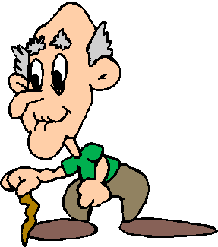
Development of a plan
Create a plan that is agreeable to both the patient and the health care providers.
Train health care team in management techniques.
Failure to provide continued reinforcement of management techniques in daily care can lead to continued failure in the professional setting.
Consider the condition of the care provider and the tasks you are asking them to accomplish!

Slide 14
Problems Associated with Resistant Behaviors
Resistant behaviors can be interpreted as a patient’s right to refuse despite the requirement to provide a certain standard of care.
Autonomy is defined as “a state of self governance, independence” American Heritage Dictionary
14th Amendment to the Constitution guarantees liberty interests Constitution of the United States
The supreme court established that liberty interests also include an obligation to provide necessary medical care to persons in institutions. Youngberg v. Romeo

Slide 15
Management of Resistant Behaviors in the Oral Health Plan
  Goal is to provide safe environment for patient and care giver.
  Goal is to provide adequate vision of and access to the oral cavity for care at home (or other problem area)
  Goal is to provide effective oral health care for the individual
  Goal is to teach how to teach these techniques for use at home
  Goal is for care giver to reinforce techniques at home to make care in professional settings easier.

Slide 16
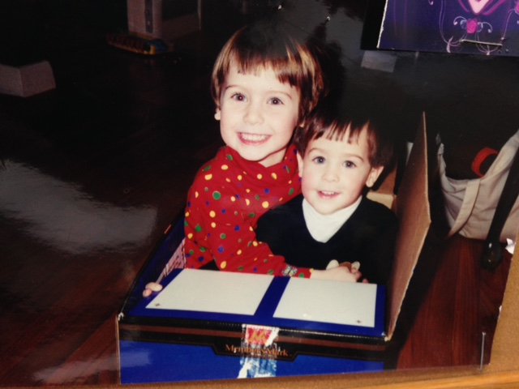

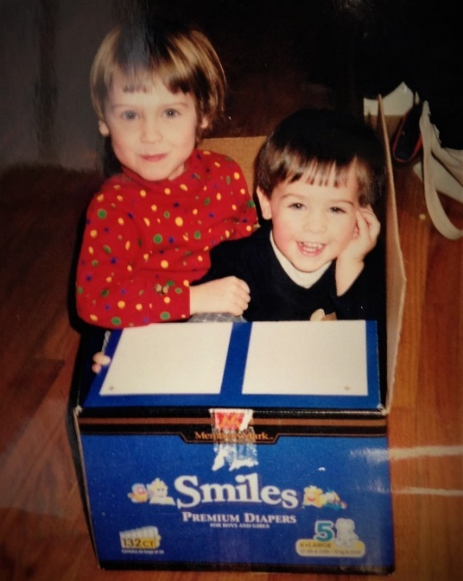
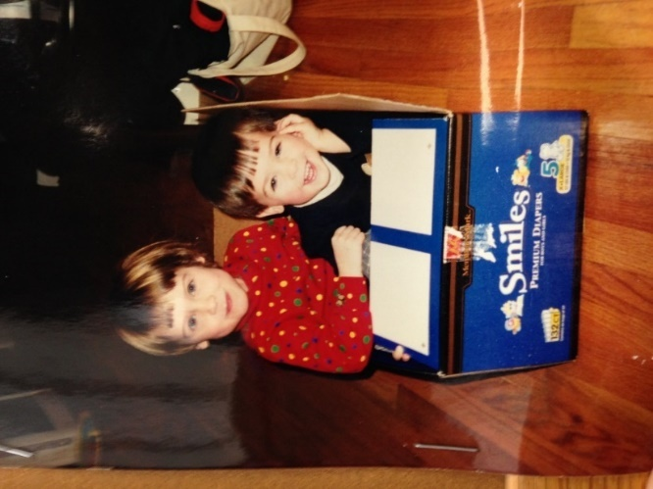
THINK OUTSIDE OF THE BOX
KEEP THE GOAL IN MIND
GET INSIDE THEIR BOX

Slide 17
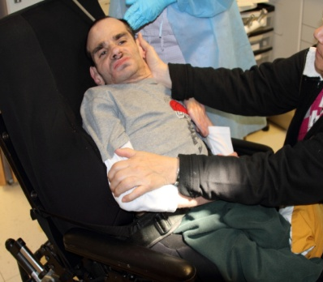
First steps in Developing Behavior Management Plan
Identify physical, behavioral, emotional, and social limitations that may prevent participation in and/or execution of an oral care plan.
Create a plan based on the individual’s needs.
Educate individuals and care givers about their management plan and ways to implement the plan that adapt to each individual’s limitations.

Slide 18
Proper Evaluation
Mentioned earlier that the first step in development of oral health plan is the evaluation. This cannot be glossed over, and proper documentation is key. Somewhere after leaving dental school, many providers fail to continue this practice. Medical / dental integration and the creation of wellness homes for people requires proper patient assessment and proper record keeping. We are health care professionals. We cannot rely on memory to continue to re-evaluate the success of the plans we create. Must not fail to document all findings and changes in the status of the patient as they occur.
Notes:
Behavior management will be based on these findings.

Slide 19
Behavioral and Emotional Deficits
Oral Health Concerns
Sensory processing needs can delay care or complicate lessons
Need environment that works for the patient
Care givers anxious about executing new procedures
Fear of harming the patient can often lead to poor oral health care practices.
Care givers overwhelmed by general care may have trouble prioritizing oral care.

Slide 20
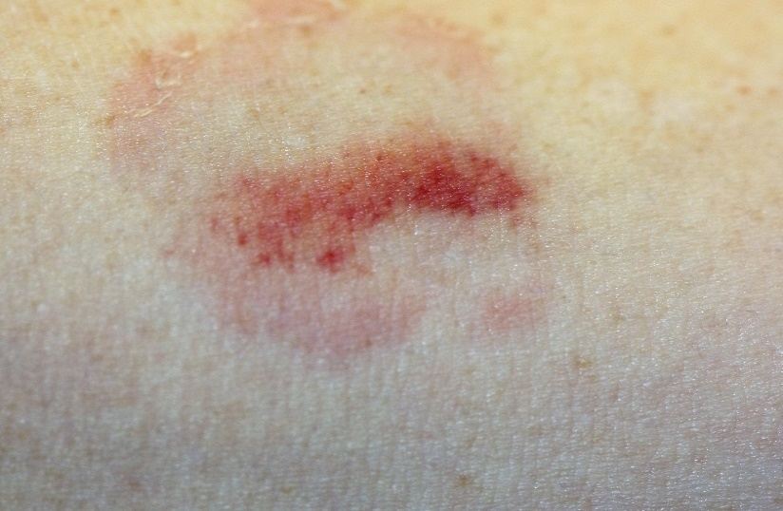
Problems Associated with Resistant Behaviors
Resistant behaviors such as lip squeezing, biting, pushing, and head turning can cause continued failure to provide care and continued neglect of oral disease.
Violent behaviors can harm the patient and/or the care giver.
Bite mark on arm of dentist.

Slide 21
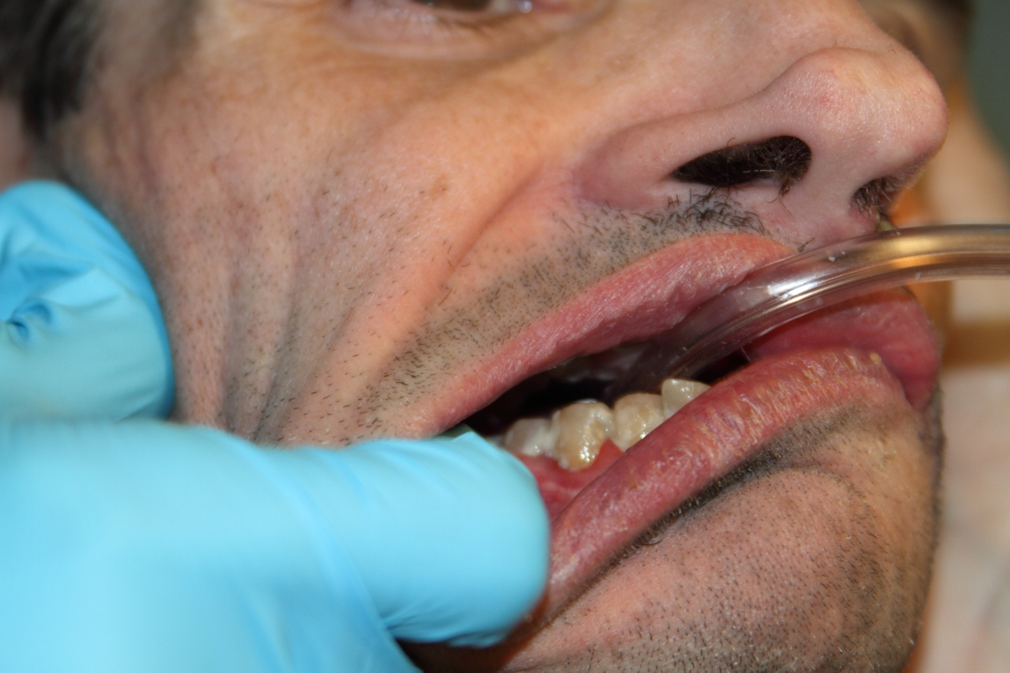
Resident with daily care
malodor
caries
Food debris and plaque
Teeth were cleaned prior to arrival, how patient presented. Wondered if all teeth needed to be extracted due to “gum disease”.
Gingivitis and periodontal pocketing

Slide 22
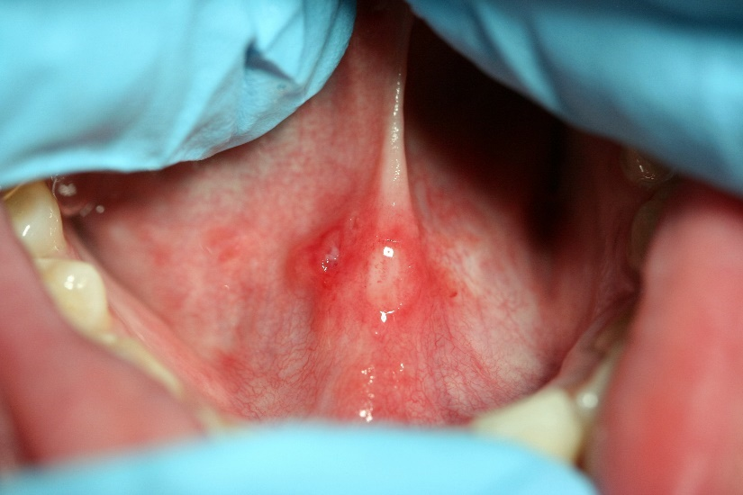
Vision and Access for Safety
The care giver unable to see the area they are treating may inadvertently injure the individual they are caring for.
Harmful actions include gagging, trauma to the lips, gums, floor of the mouth or cheeks, stretching , or grabbing.
Traumatic ulcer

Slide 23
Possible Sources of Resistant Behavior
Resistance may be a habit utilized in many life skills.
Resistance may be due to fear. Fear may be of obvious reasons or subtle reasons harder to identify.
Resistance may be a learned behavior that can be changed.
Resistance may be due to underlying disability or impairment.
Resistance may be due to history of pain with oral care.
Overcoming Obstacle to Oral Health, University of the Pacific 2015

Slide 24
Possible Sources of Resistant Behaviors
Many care givers and individuals we care for may not be capable of understanding the importance of good oral hygiene.
Attempting to educate an individual with limited knowledge of the importance of oral health can be challenging.
Often resistance to learning or inability to process the information can prove to be frustrating for everyone.
Notes:
They don’t understand you statement we hear all the time.

Slide 25
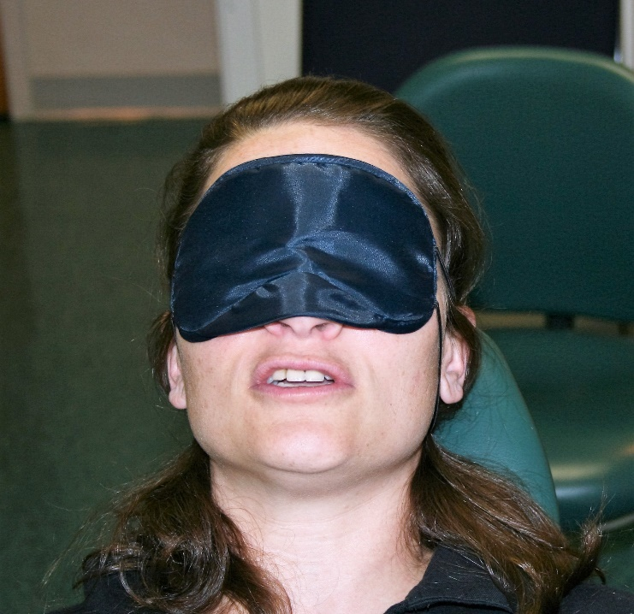
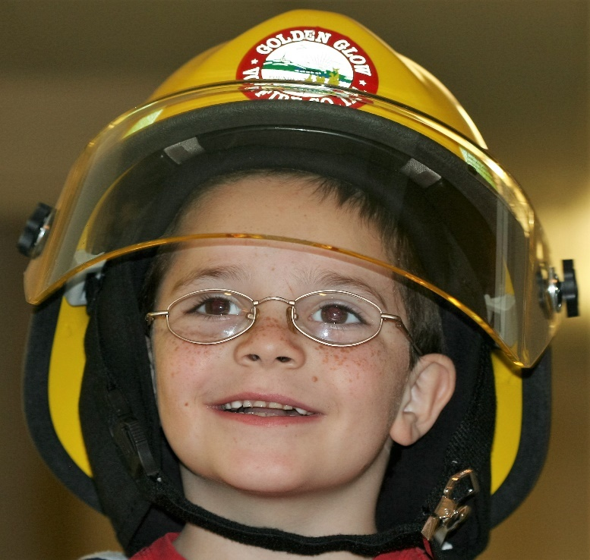
Behavior Management in the Health Plan
Developed to meet the specific needs of the individual in order to accomplish good oral care.
Behavioral modification can be included in oral plan and utilized with other daily living skills.

Slide 26
Behavior Management Techniques
Complex medical management
Tell-show-do
Positive reinforcement
Communicate with the patient
Shaping
Distractions
Sequential Desensitization
Modeling
Medical Immobilization Protective Stabilization
Handbook of Psychological Assessment 2009

Slide 27
Complex Medical Management
Several co-morbidities can be difficult to manage on their own
Conditions may have adverse effects on oral health to consider
Poor oral health may be causing medical complications
ORAL DISEASE
HEART DISEASE AND STROKE²
POOR BIRTH OUTCOMES³
DIABETES⁴ AND PANCREATIC CANCER⁵
PNEUMONIA¹
MAL-NUTRITION^{5,6}
GASTRO-INTESTINAL DISORDERS⁷
See References for Oral Health and Overall Health

Slide 28
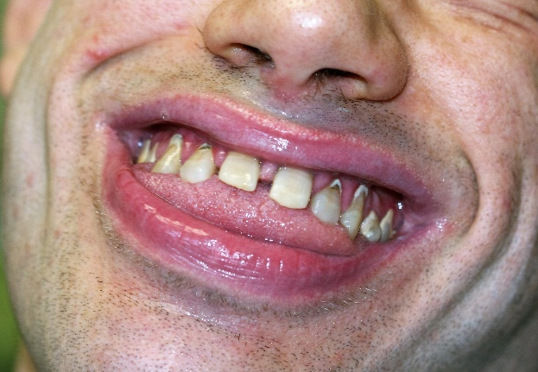
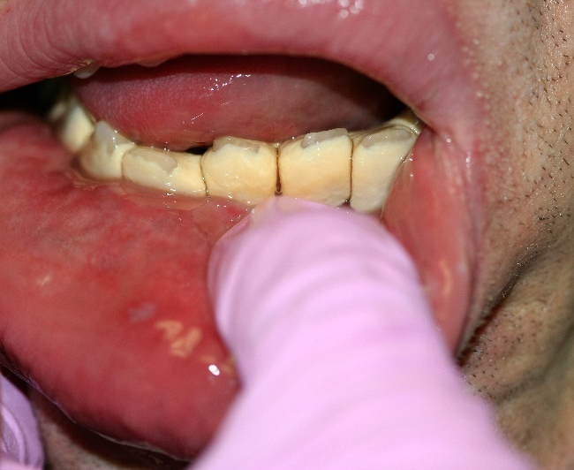
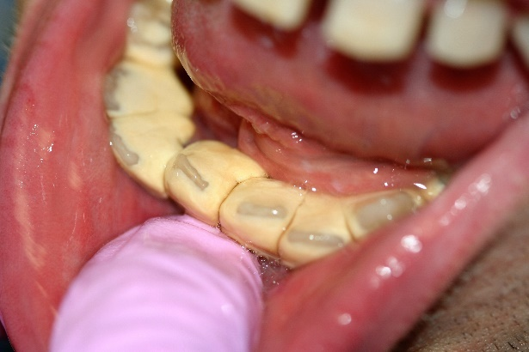
Complex Medical Management
Numerous medications to monitor
Physically limiting conditions for providing or receiving care
Compromised airway, positioning restrictions
Lip trauma from lip curling
Care giver could not visualize or access lower teeth
Tongue thrusting behavior

Slide 29
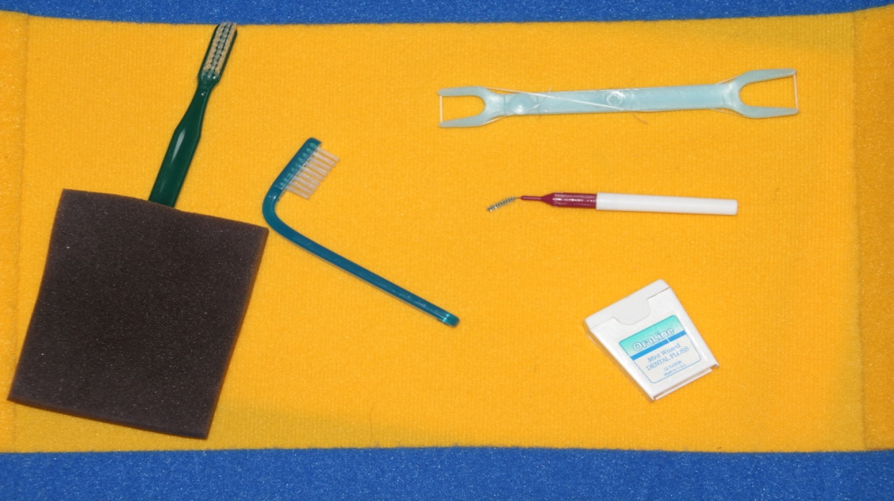
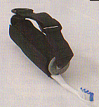
Equipment Adaptations
Adaptations in equipment can make it easier for care giver to reach mouth without hand/fingers in mouth
Easier to utilize hand over hand assistance
Creative, easy and comfortable for patient and/or care giver

Slide 30
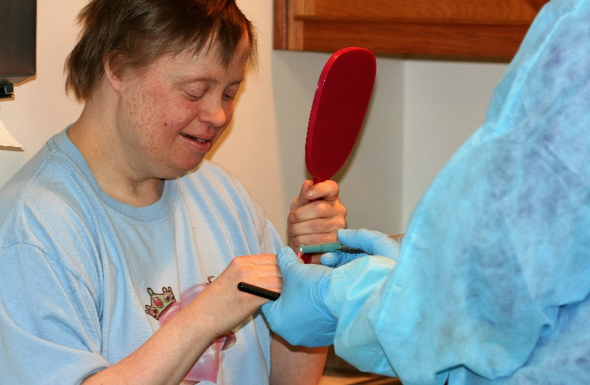
Tell-show-do
Tell what going to do
Show what using and allow to touch hear, etc.
Do procedure after clear that they understand if possible to evaluate
This is beneficial to by-standers as well.
Running polisher on finger.
Can set slow speed to backward and run on hand with bur in place.
Can “do” on trusted other person in the room.

Slide 31
Positive Reinforcement
A behavior is followed by the presentation of an appetitive (desired) stimulus, increasing the probability of that behavior.
Negative reinforcement involves a negative stimulus when undesired actions occur. Generally, positive reinforcement is more effective.
Not the same as bribing in which the promised item for positive behavior is offered before the action occurs.

Slide 32
Communicate With The Patient
Care givers of individuals with severe cognitive limitations cannot truly know the level of understanding the person they care for has due to limitations in testing cognitive ability.
Handbook of Psychological Assessment 2009
Discuss problems and solutions and what doing whether or not they can respond or are “capable” of understanding.
Communicate to the patient’s intellectual level.
Use terms that are not scary but still truthful.
  Handpiece or electric toothbrush instead of drill.
Notes:
Remember to mention to have this discussion outside of earshot of patient if possible

Slide 33
Shaping by Successive Approximations
A behavioral method that reinforces responses that successively approximate and ultimately match the desired response.
  Occupational therapists can be utilized for this.
  Rewarding each step that will eventually lead to the desired goal.
Standing by the chair
Sitting on the edge
Swinging legs around
Resting head on head rest
Staying in chair

Slide 34
Distractions
Using the environment to redirect the patient’s attention from procedure
Music, movies or TV, virtual
Ask patient, staff, care givers, other healthcare professionals what has worked for other undesirable situations.
Add difficult task to enjoyable task
  Brush teeth in bath tub
  Brush teeth while watching TV
  Sing to person
  Ask yes or no questions to have a conversation

Slide 35
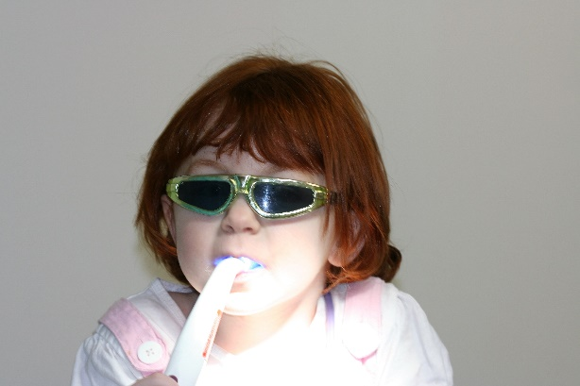
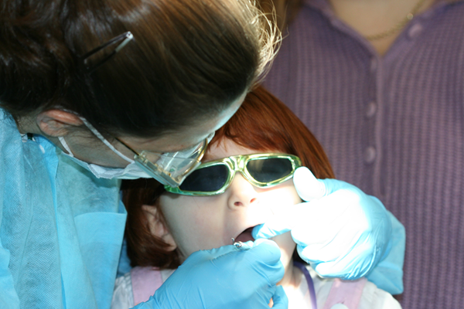
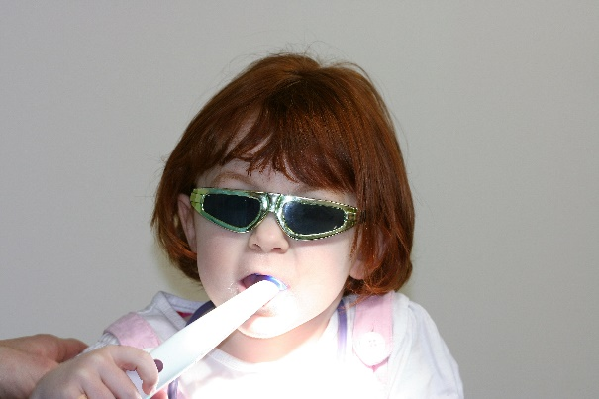
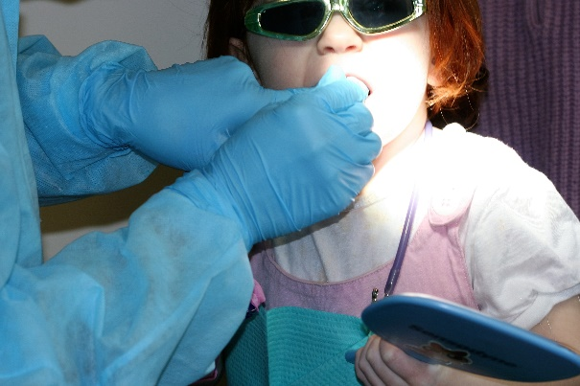
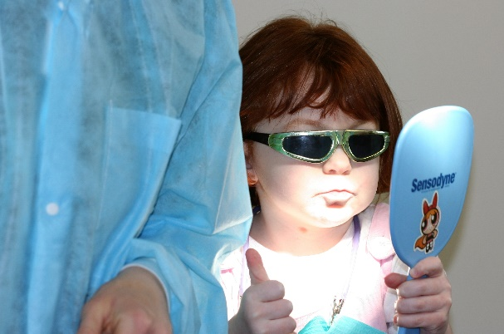
Behavior Management Techniques
Sequential Desensitization: Dividing procedures into pieces and conquering each one separately. Methodical introduction of stimuli to accomplish final goal.

Slide 36
Behavior Management Techniques
D-Termined technique: Program of familiarization and sequential tasking. Patient is informed of how much time they must cooperate, what going to do during that time, and told that they will be given a break at that time. (Counting up to 5, gradually increasing to ten, etc). Developed by Dr. David Tesini, available from Specialized Care Company, http://www.specializedcare.com

Slide 37
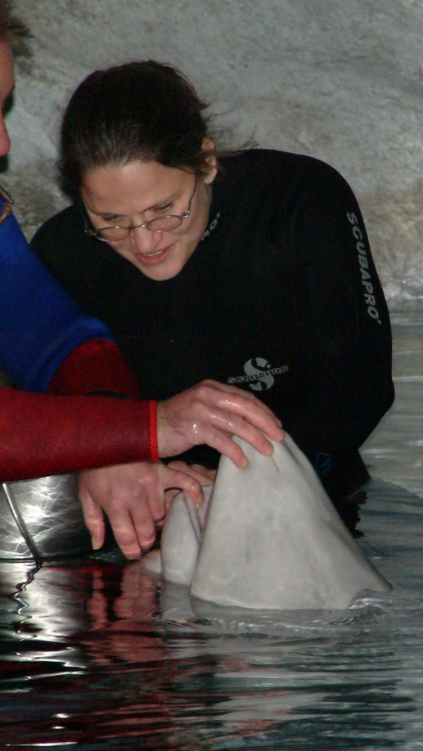
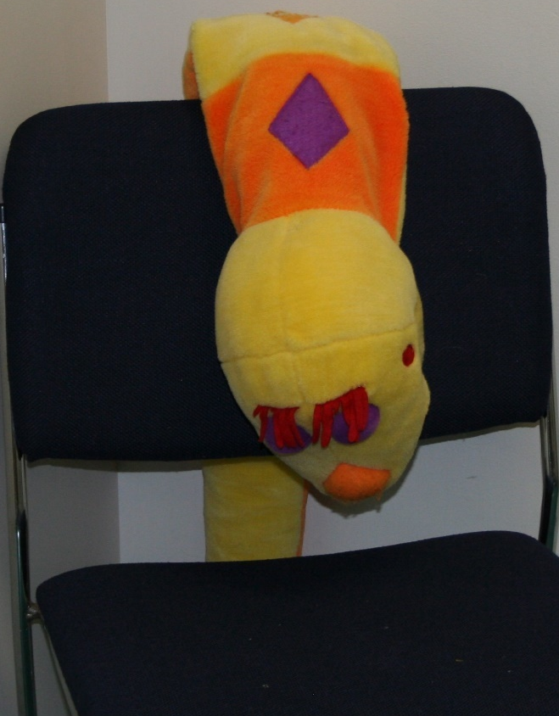
Modeling
Showing what doing in different setting or on different subject

Slide 38

Decision Making
The process of choosing between alternatives; selecting or rejecting available options.
Choices should be limited, choices should not include not doing desired actions
“Do you want a piece of fruit now?”
“Do you want an apple or an orange now?”

Slide 39
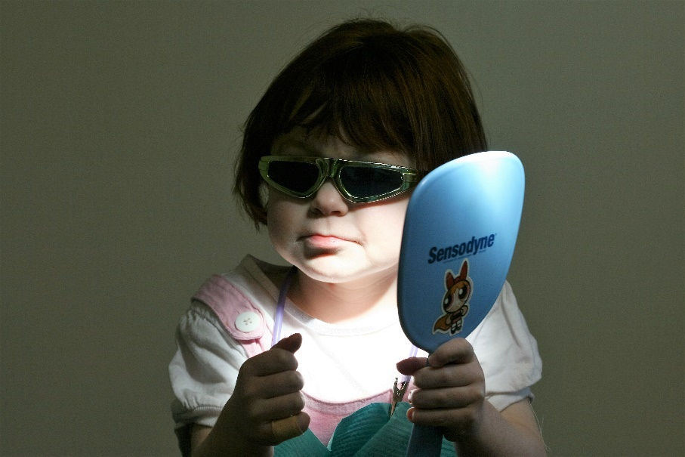
Perceived control
The belief that one has the ability to make a difference in the course or the consequences of some event or experience; often helpful in dealing with stressors .
Giving control back to the patient over what their fear or anxiety factors may be.
Logan, H., Risner, A., Muller, P. “Anticipatory Stress Reduction Among Mixed Pain Patients. “ Special Care in Dentistry. Vol. 116, No. 1, pg. 1-7, 1996

Slide 40
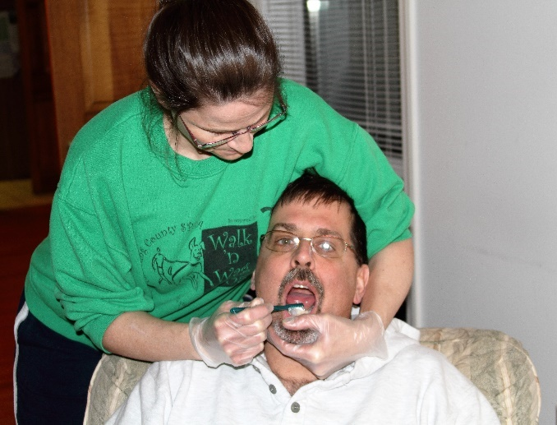
Location
Bathroom:
  at sink
  seated on stool with hand, pillow, or towel supporting head
  In tub as part of bathing
Living room or bedroom:
  Television , music, etc. provide a good distraction for many individuals, can be used to reinforce reaching small goals in plan
  Can have water cup and “spittoon” cup as working
  Can brush with only water
  Remove excess toothpaste or solutions with toothette or cloth

Slide 41
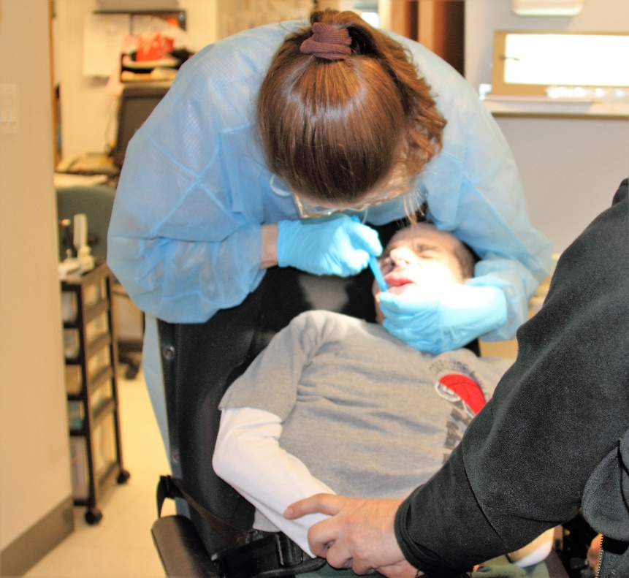
Location
Office setting
  In separate chair in room
  In own wheel chair or other mobility device
  On floor
  Standing up
  Sitting Down
  In hallway
  In waiting room
  In treatment room

Slide 42
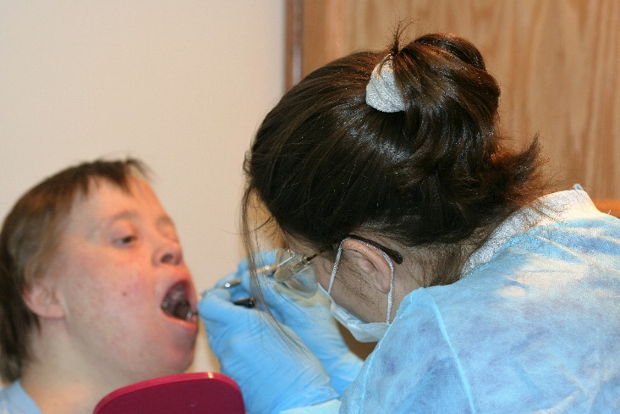
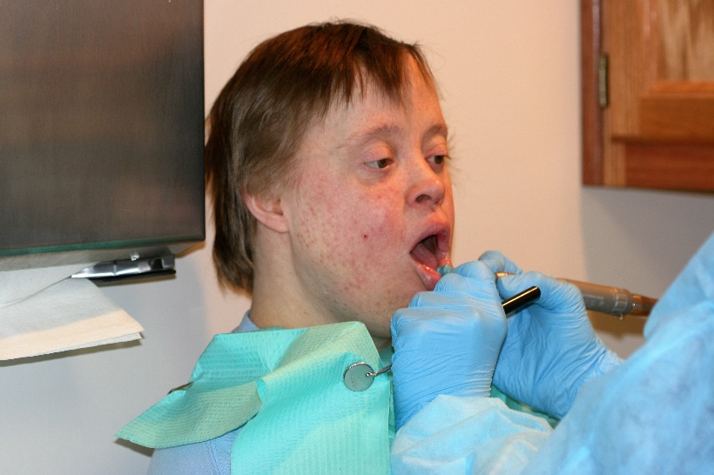
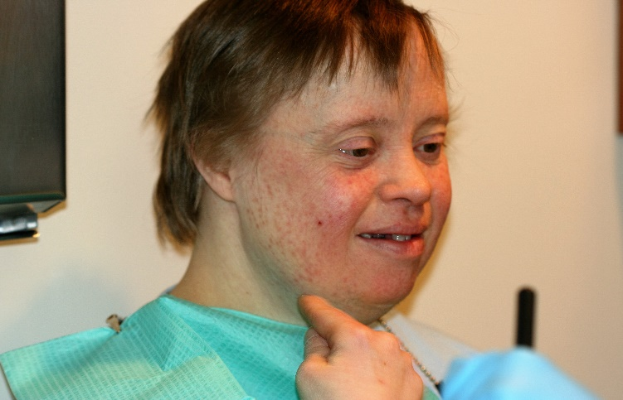
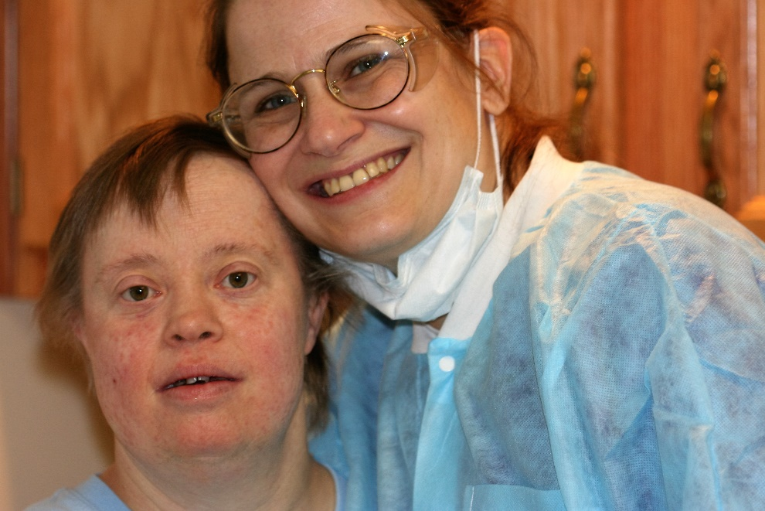
Behavior Management Techniques
Scaling no problem at sink
Polishing in mouth for five count
Break time to spit into sink

Slide 43
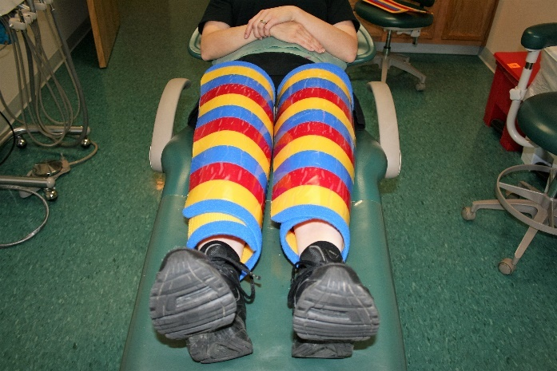
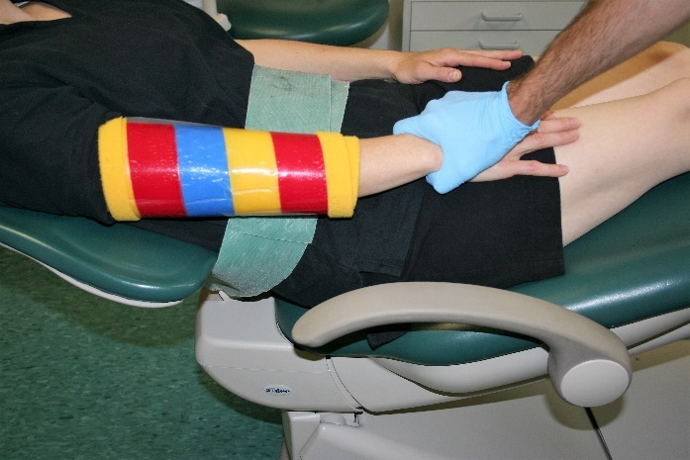
Behavior Management Techniques
Medical Immobilization and/or Protective Stabilization: Manual, physical, or pharmacologic limitation of unfavorable actions
Definitions provided by Glossary of Psychological Terms from American Psychological Association http://www.apa.org/research/action/glossary.aspx?tab=18

Slide 44
Behavior Management Techniques
Limiting movements that prevent interfere with care
Gentle holds of short duration to overcome physical and behavioral obstacles can become part of the plan
Certain immobilization devices can be prescribed by the dental professional and ordered for use at home and in professional settings with proper training
Informed consent must be obtained from the legal guardian for any techniques before they are utilized except in the case of an emergency

Slide 45
Medical Immobilization and Protective Stabilization Plans MIPS
Plan must start with least restrictive intervention techniques, advancing to more restrictive interventions only when documentation shows previous efforts have failed safe completion of the task.
Time limitations are specified by federal and state law. Record duration time and number of breaks if given.
  Helpful to describe type of stabilization for future appointments.
  Pictures are the best way to remember what worked!

Slide 46
Restraint vs. Help
It is important that the individual view the oral hygiene process as helpful.
Local, state and federal, laws and guidelines, must be followed. Informed consent from legal guardian may be required.
Stabilization of short duration for the safety of the care giver and the patient may be necessary to accomplish oral care.
The techniques can be utilized as part of the person’s oral hygiene plan and written as a modification to a patient’s plan of care (usually only applicable institutional type settings). Public Health Code of Federal Regulations #42 Part 482 to End, Revised October 1, 2010
Any of these techniques must be viewed as safety measures and NEVER as punishment.
Notes:
This is where there are issues. If you need a patient stabilized, get approved and put into daily action plan.

Slide 47
What is “Restraint”
(A) Any manual method, physical or mechanical device, material, or equipment that immobilizes or reduces the ability of a patient to move his or her \ arms, legs, body, or head freely;
(B) A drug or medication when it is used as a restriction to manage the pa­tient's behavior or restrict the pa­tient's freedom of movement and ls not a standard treatment or dosage for the patient's condition.
Public Health Code of Federal Regulations #42 Part 482 to End, Revised October 1, 2010.

Slide 48
What is not a Restraint
(C) A restraint does not include de­vices, such as orthopedically prescribed devices, surgical dressings or bandages, protective helmets, or other methods that involve the physical holding of a patient for the purpose of conducting routine physical examinations or tests, or to protect the patient from falling out of bed, or to permit the patient to participate in activities without the risk of physical harm (this does not in­clude a physical escort).
­Public Health Code of Federal Regulations #42 Part 482 to End, Revised October 1, 2010.

Slide 49
Limited holds of brief duration while performing oral care
Put in plan after other techniques have failed
Continue to try other techniques before implement
May need to have behaviorist put into plan
Must be re-evaluated on a regular basis
Document
  techniques tried
  holds needed
  number of breaks given
  length of time hold required to achieve goal
  SUCCESS OR FAILURE

Slide 50
Safety stabilization and holds
Holding hands down
  Prevents grabbing
  Prevents blocking
Holding head still
  Allows safe access to mouth
  Cannot “hit” a moving target
Holding or restraining torso
  Prevents sudden movements while aids in mouth
  Allows time to see and treat
DO NOT BE AFRAID TO PUT INTO PLAN TO BE APPROVED IF NEED IT

Slide 51
Mouth Props
Mouth props ARE NOT a restraint.
All props should be used with care to avoid gum injury.
Props can be utilized to
  Open mouth and keep open
  Protect resident and care giver from unexpected closure
  Move tongue, cheek or lip to provide access to teeth

Slide 52
Mouth Props
Tongue blade mouth prop-2 or 3 tongue blades taped together with adhesive tape
Clean rubber door stop can be a good prop.
Numerous durable rubber items are available in the pet toy section of most stores. Stops should be chosen that least resemble a pet toy but are strong enough to withstand the forces of the human jaw
Open Wide props from Specialized Care Company
All props should be washed, labeled and kept with the person’s dental supplies.
Take prop out of mouth after each quadrant to allow person you are assisting to swallow saliva and rest the jaw.

Slide 53
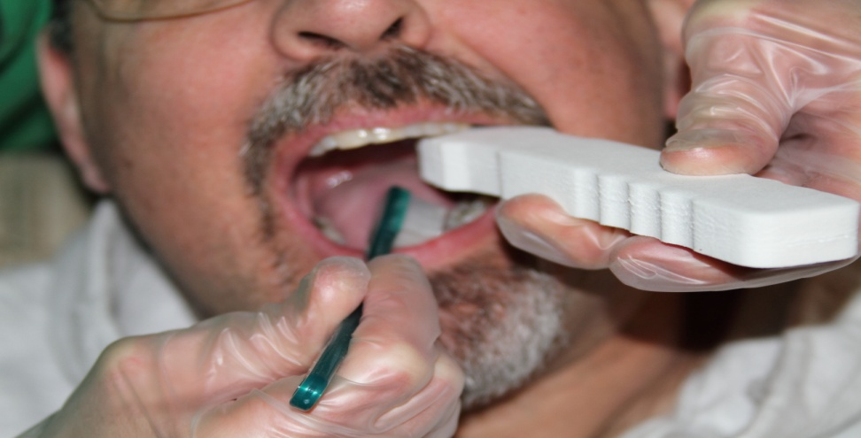
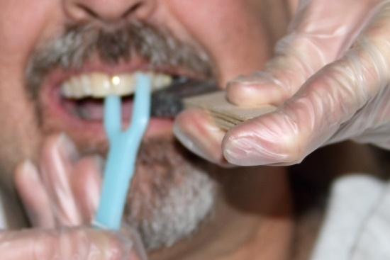
Mouth props
As patient bites down on one side, perform care on the other.
Keep on the BACK teeth.
Do not push backward with prop, but upward against the upper arch which is stable. This way if they open more, you will not slip further into the mouth.
Give a break from the prop after each quadrant is completed with task performing.
One person can stabilize with head and prop while another performs oral care

Slide 54
Safe and Effective Head Stabilization
Pressure on boney prominences (forehead, cheek bone, lower jaw)
Pressure opposite direction to resistance from resident
Pressure of equal or less force to that from resident
Preventing movements, not necessarily relocating
Use hands, arms, shoulder, chest
Cradle against yourself or against a chair, wheelchair, couch, bed, pillow, etc.

Slide 55
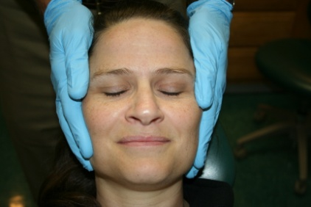
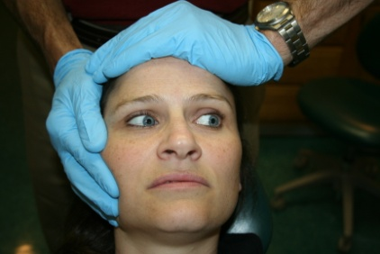
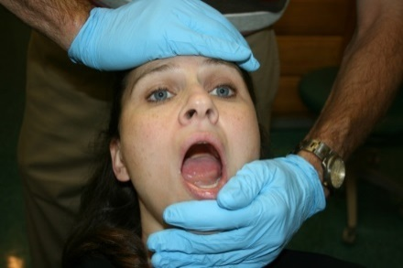
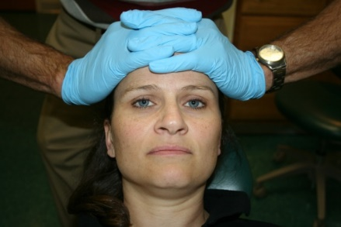
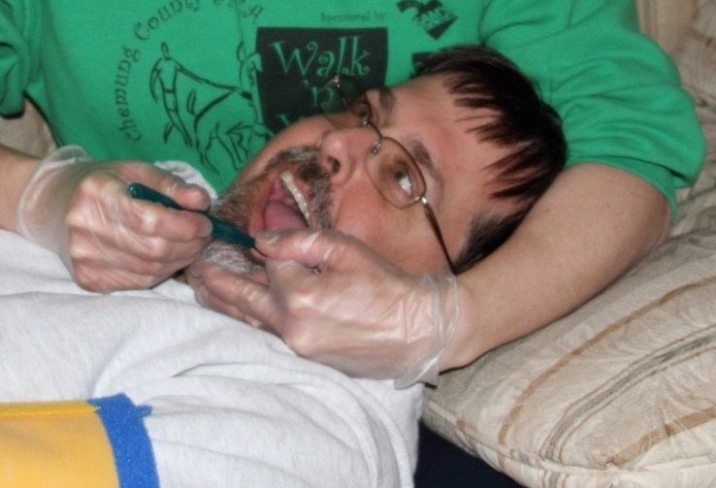
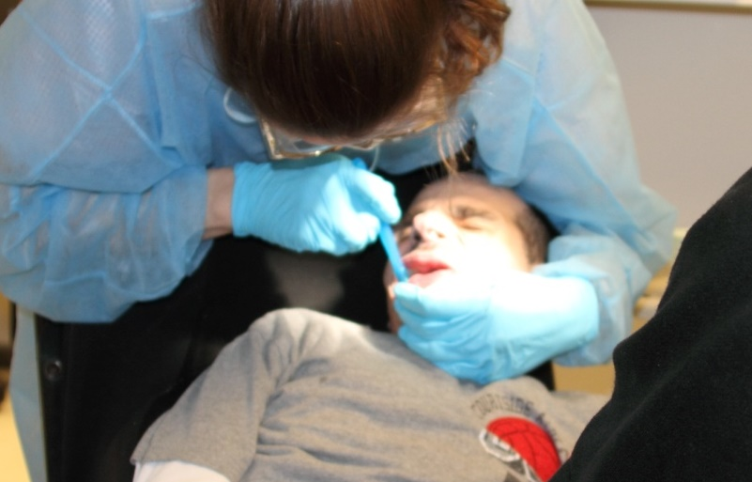
Safe and Effective Head Stabilization
Pressure on boney prominences.
Cradle against stable object or chest

Slide 56
Unsafe and Ineffective head Stabilization
Do not overextend head
Do not place pressure on the area where the head meets the next (atlanto-axial joint)
Do not push under the jaw into the area under the tongue (floor of the mouth)
Do not push head into chest
Do not grab ears, nose, or lips
Do not pull hair
NEVER HAVE HANDS OVER THROAT AREA

Slide 57
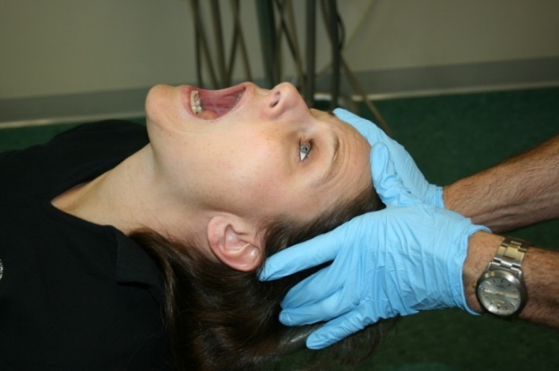
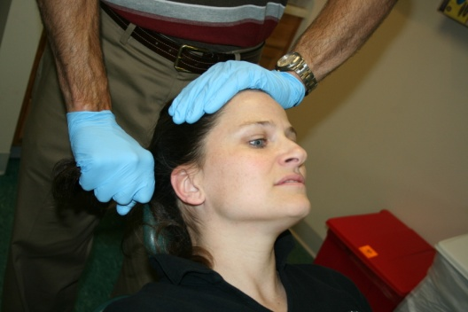



Unsafe and Ineffective head Stabilization
Hyperextension
Hair pulling
Pushing down
Fingers on jaw bone, not area under the bone
Ears, nose and lips are not handles

Slide 58


Positioning for visualization and safety
Try for positions that allow you to see
into the mouth, control the head, and protect your back.
Stabilize the patient’s neck and back.
Reclining at least 30 degrees unless medically contraindicated
Can change position during session to give patient and care giver a break

Slide 59






Limb Stabilization
Release hold whenever not performing the task
Never apply pressure directly over a joint
Hold long bones only Do not twist skin
Joint stabilizers can be prescribed by a physician or dentist and ordered Specialized Care Company
Strongest neck in the west!!

Slide 60


Torso Stabilization
Usually requires two care givers
Seated wrap can be accomplished in any chair, want 25 degree tip back if possible
Skinny chair easiest, have “wrapper” behind the chair keeping the arms crossed, back pressure to keep from moving forward
Blanket or sheet can be used to wrap , have patient back against the folded edges, or clip

Slide 61


Full Body Immobilization
Use immobilization vocabulary
“Papoose” has negative connotation
Wrap, snug as bug, snuggle are favorable and used for many situations

Slide 62


Monitoring
Pressure points
Temperature
Respiration
Heart rate
PATIENT DISPOSITION
Never inhibit breathing
Watch for pressure points
Have patient wear long sleeves and pants

Slide 63
Documentation
  Informed consent: Risk vs. benefits DISCUSSED and understood. Obtained written and orally.
  Reason for intervention.
  Previous less restrictive interventions tried.
    May be documented elsewhere (last visit), should always try less invasive first.
  Technique: What was done
  Who provided technique: Staff, family, etc.
  Duration of technique: Time from start of intervention
  Level of cooperation achieved.
  Affirmation of future plan.
  Who was present at the time of the intervention

Slide 64
Sample BMT for Home Brushing
Occupational Therapist or Speech Therapist can be utilized for facial, oral, or other stimulation and acceptance of oral health aids.
Break session into sections. Tell what area doing, give break when finished, move to next. The D-Termined Method
Have a record of areas cleaned at each session available in the person’s hygiene kit for easy tracking. This will help ensure that the entire mouth is covered over time rather than one area repetitively.

Slide 65

Sample BMT note
Pt. reports for sealants on #3, #14. Previous attempts have failed due to patients continued head posturing to left and reaching up with hand to touch nose. Informed consent obtained for head stabilization and hand holding. Dental assistant able to stabilize head with hand, mouth prop also used. Mom held hand. Total time: 30 minutes with breaks between teeth treated. Pt. mostly cooperative, able to complete procedure. NV: Same BMT for restorative.

Slide 66
Summation
Health care is difficult when the person being cared for is resistant to or does not understand care.
Good oral health is necessary for the health and well being of everyone in our care.
Resistance to a life skill does not constitute an excuse for supervised neglect.
Behavior management techniques can be used in any setting to improve the success of the health plan with the assistance of the entire care team.

Slide 67


Summation
A behavior management plan is needed for all stages of the health care plan.
Well trained and motivated patients, care givers, and practitioners can achieve success.
RISE TO THE CHALLENGE
THINK OUTSIDE OF THE BOX/INSIDE OF THEIR BOX

Slide 68


Questions?
Thank you
Dr. Alicia Risner-Bauman
arbdds@gmail.com

Slide 69
OPWDD Putting People First
Medical Immobilization Protective Stabilization
Acknowledgement
• Joseph Bonanno, M.D. Taconic DDSO
• Paul Byron, M.D.Capital District DDSO
• Craig Colas, D.D.S.Broome DDSO
• Vince Filanova, D.D.S. Capital District DDSO
• Kathleen Keating, R.N., MSN, CPNP-PC, CNS/DDNYS OPWDD
Rick MacRae, D.D.S
• James MaierCapital District DDSO
• Paul Partridge, Ph.D.Capital District DDSO
• Marcia Rice, RN, BSN, MS, CDDN NYS OPWDD
• Maureen Romer, DDS, MPAArizona School of Dentistry &Oral Health

Slide 70
References Oral Health and Overall Health
Frank A. Scannapieco Associations Between Periodontal Disease and Risk for Nosocomial Bacterial Pneumonia and Chronic Obstructive Pulmonary Disease. A Systematic Review. Annals of Periodontology. December 2003, Vol. 8, No. 1, Pages 54-69.
J.M. Liljestrand, et.al. Association of Endodontic Lesions with Coronary Artery Disease. Journal of Dental Research (July 27, 2016).
Saini and Saini, Perioeontitis: A risk for delivery of premature labor and low-birthweight infants. J Nat Sci Biol Med. 2010 Jul-Dec; 1(1): 40–42.
Moore, Orchard, Guggenheimer, and Weyant. Diabetes and Oral Health Promotion: A Survey of Disease Prevention Behaviors. Journal of the American Dental Association. Sept. 2000, Vol 131, Issue 9, pgs 1333-1341.
Farrell, et.al. Variation of oral microbiota are associated with pancreatic diseases including pancreatic cancer. Gut. 2012, 61:4 582-588.
Robertson, MD. and Montagnini, MD. Geriatric Failure to Thrive. American Family Physician. 2004 JUL 15; 70(2):343-350.
Emami, et.al. Impact of Edentulism on Oral and General Health. International Journal of Dentistry. Volume 2013, ID 498305.

